Slide 1
Web Development Workshop
SVCE-ACM Student Chapter in collaboration with ACE, Interrupt 2k17
Ganesh Jayaraman and Keshav Aditya R P

Slide 2
Why Web Development ?
Web Development is simple and easy to follow.
Almost every business out there have websites to market themselves and take them to the next level
Career Paths :
Frontend Dev - Client Side Scripting
Backend Dev - Server Side Scripting
Full Stack Web Dev - One who does Both !

Slide 3

Frontend Vs Backend Web DevDevelopment ?
Being a Frontend developer you need to be more creative and be able to implement a wide range of designs provided by the UI designer.
Manipulate the DOM at will by the means of javascript to create an interactive dynamic website
Always have the end user and mind and ensure the website created is highly responsive
Being a Backend developer you need to have a complete understanding of the database and the data in it.
Writing Efficient Queries that less burden the server

Slide 4
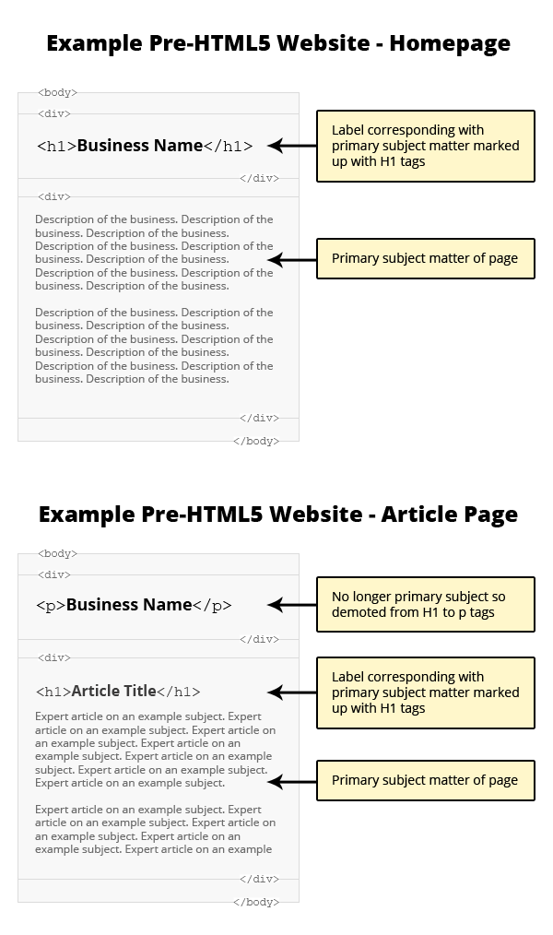
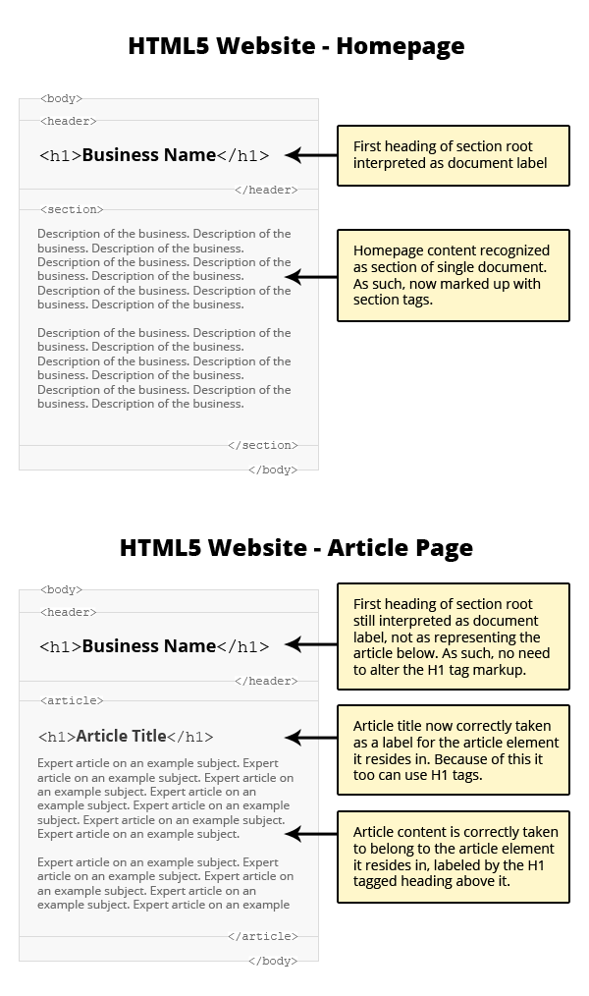
The Myths about h1, h2, h3 etc tags
Are they used to displayed a larger font ?
Yes
Well absolutely Not !
They serve a greater purpose.

Slide 5
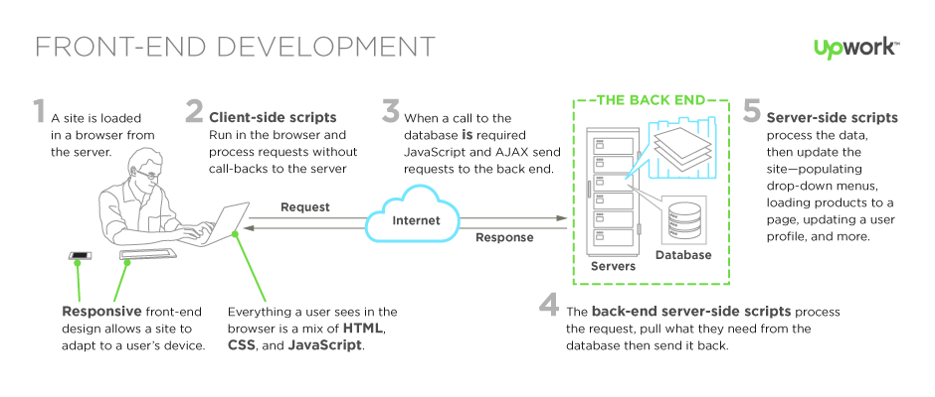
Frontend Backend Interaction ! .

Slide 6
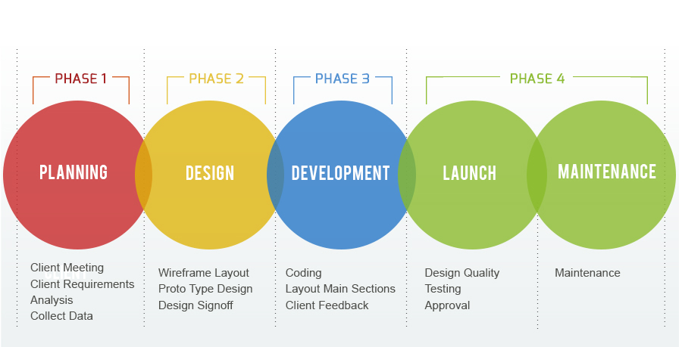
Trust the Process

Slide 7


Thank You
Hope you guys were able to follow and we wish you the very best for your future
What you need ask yourselves Is web development enough ? Does it solve all our problems ?
What are the latest trends in technology What is Iot, Machine Learning, AI ? Where do i start ?
.

